Slide 1
BCSE204L Design and Analysis of Algorithms
Module-1 Topic-5: Karatsuba Algorithm (D&C)

Slide 2
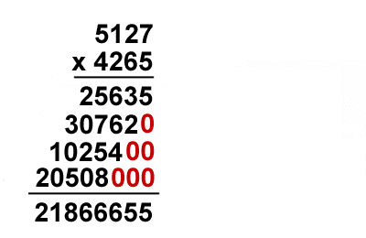
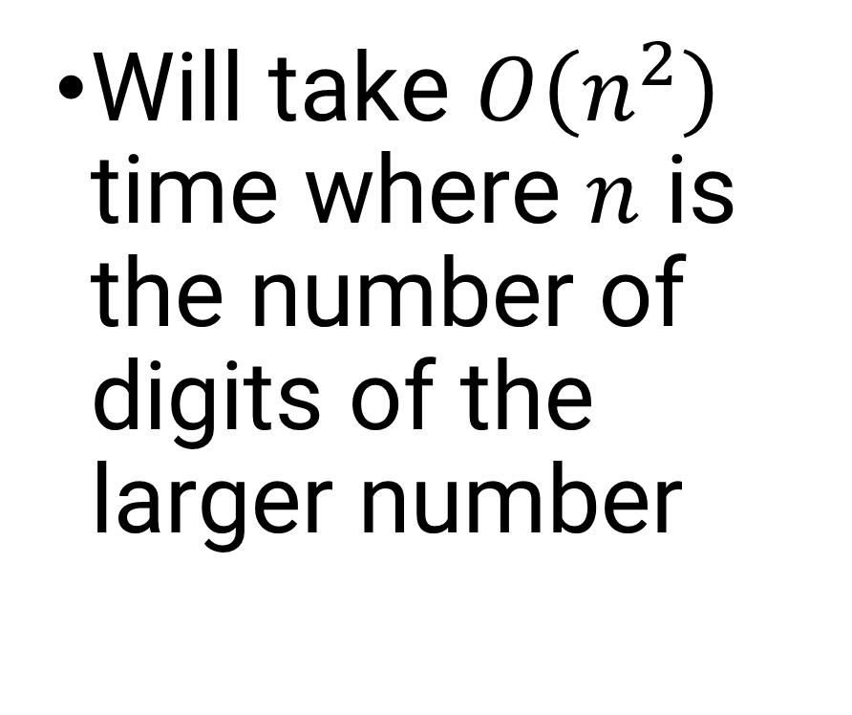
Multiplying Large Integers
Will take $O\left(n^{2}\right)$ time where $n$ is the number of digits of the larger number

Slide 3
Karatsuba Algorithm
In Information Security, cryptography, number theory etc., integers of length 128/246 are to be multiplied
Traditional multiplication becomes expensive
D&C techniques can save time
Karatsuba Algorithm, put forward by the Russian Mathematician Anatoli Karatsuba in 1962 for faster integer multiplication

Slide 4
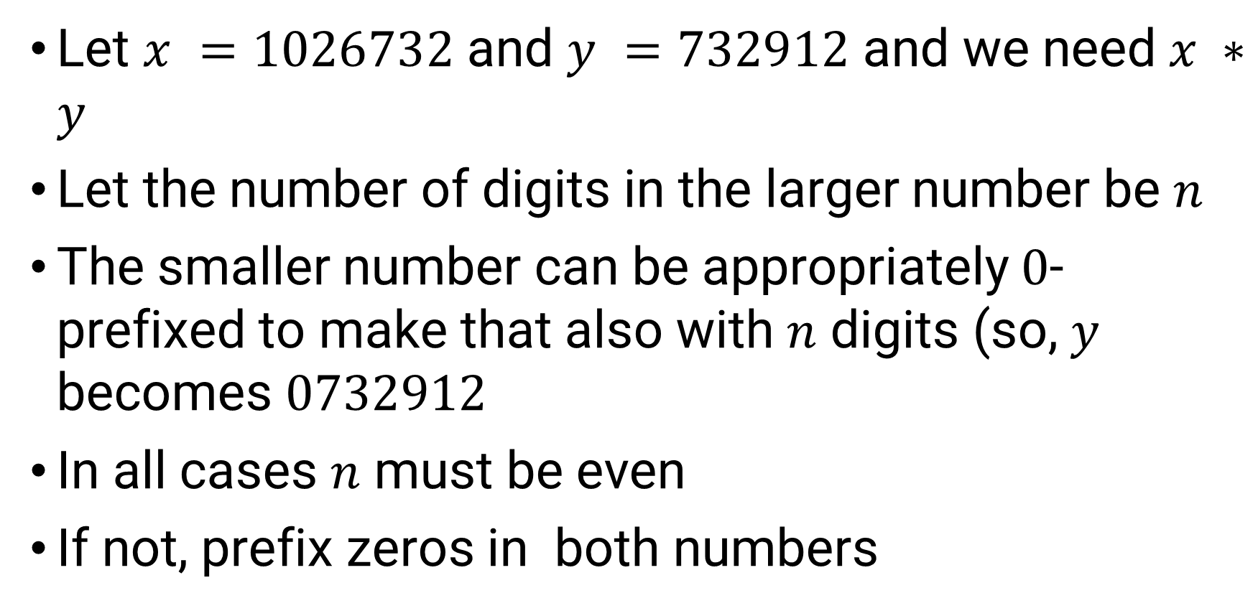
Karatsuba: Basic Rules
Let $x =1026732$and $y =732912$and we need $x ∗y$
Let the number of digits in the larger number be $n$
The smaller number can be appropriately $0$-prefixed to make that also with $n$ digits (so, $y$ becomes $0732912$
In all cases $n$ must be even
If not, prefix zeros in both numbers

Slide 5
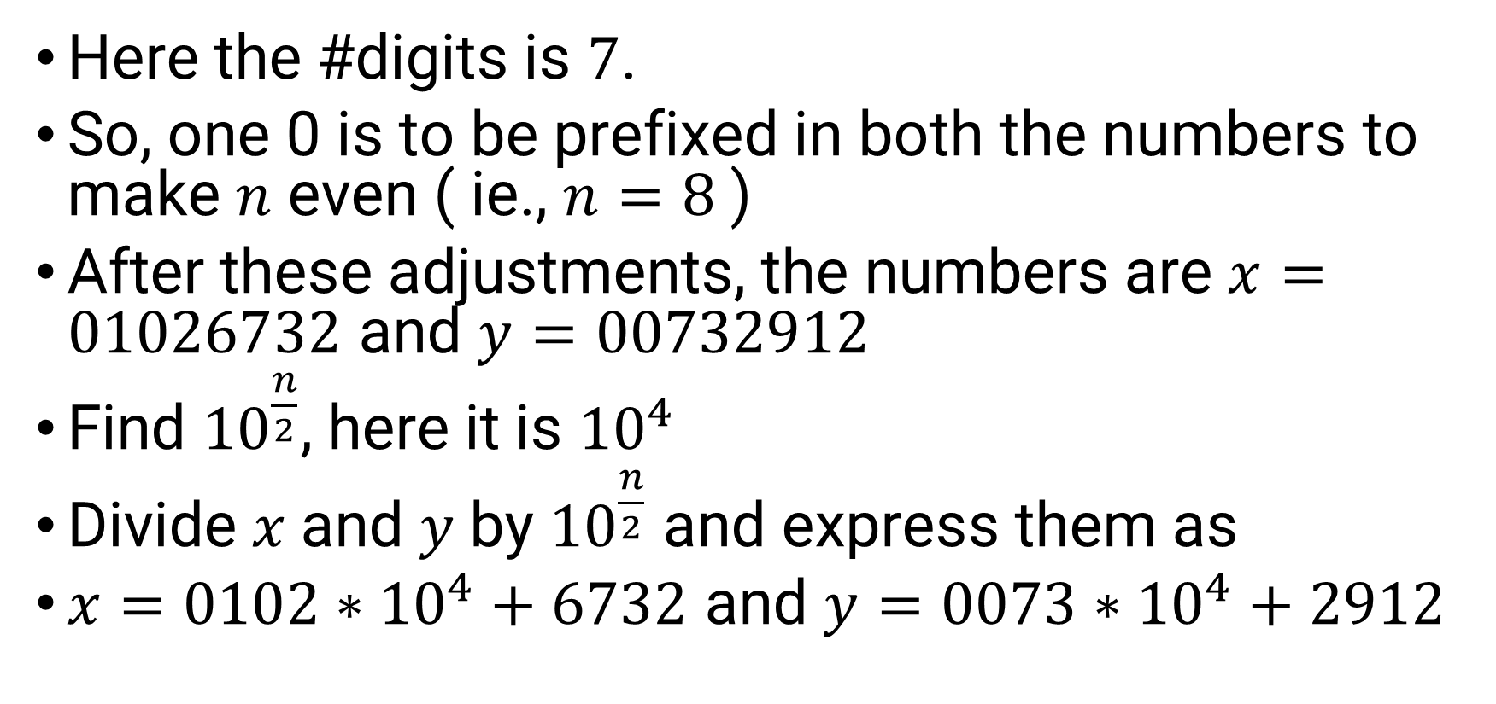
Karatsuba: Applying Rules
Here the #digits is $7$.
So, one 0 is to be prefixed in both the numbers to make $n$ even ( ie., $n=8$ )
After these adjustments, the numbers are $x=01026732$ and $y=00732912$
Find ${10}^{\frac{n}{2}}$, here it is ${10}^{4}$
Divide 𝑥 and 𝑦 by ${10}^{\frac{n}{2}}$ and express them as
$x=0102∗{10}^{4}+6732$ and $y=0073∗{10}^{4}+2912$

Slide 6
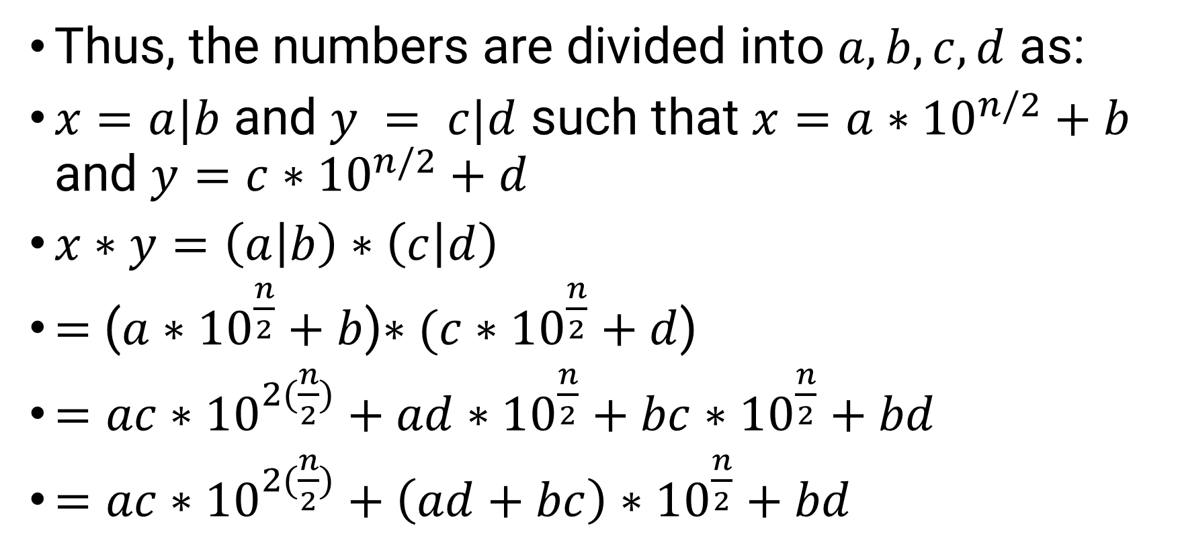
Karatsuba: Generalising
Thus, the numbers are divided into $a,b,c,d$ as:
$x=a|b$ and $y = c|d$ such that $x=a∗{10}^{n/2}+b$ and $y=c∗{10}^{n/2}+d$
$x∗y=\left(a | b\right)∗\left(c | d\right)$
$=$ ($a∗{10}^{\frac{n}{2}}+b$)$∗(c∗{10}^{\frac{n}{2}}+d$)
$=ac∗{10}^{2(\frac{n}{2})}+ad∗{10}^{\frac{n}{2}}+bc∗{10}^{\frac{n}{2}}+bd$
$=ac∗{10}^{2(\frac{n}{2})}+\left(ad+bc\right)∗{10}^{\frac{n}{2}}+bd$

Slide 7
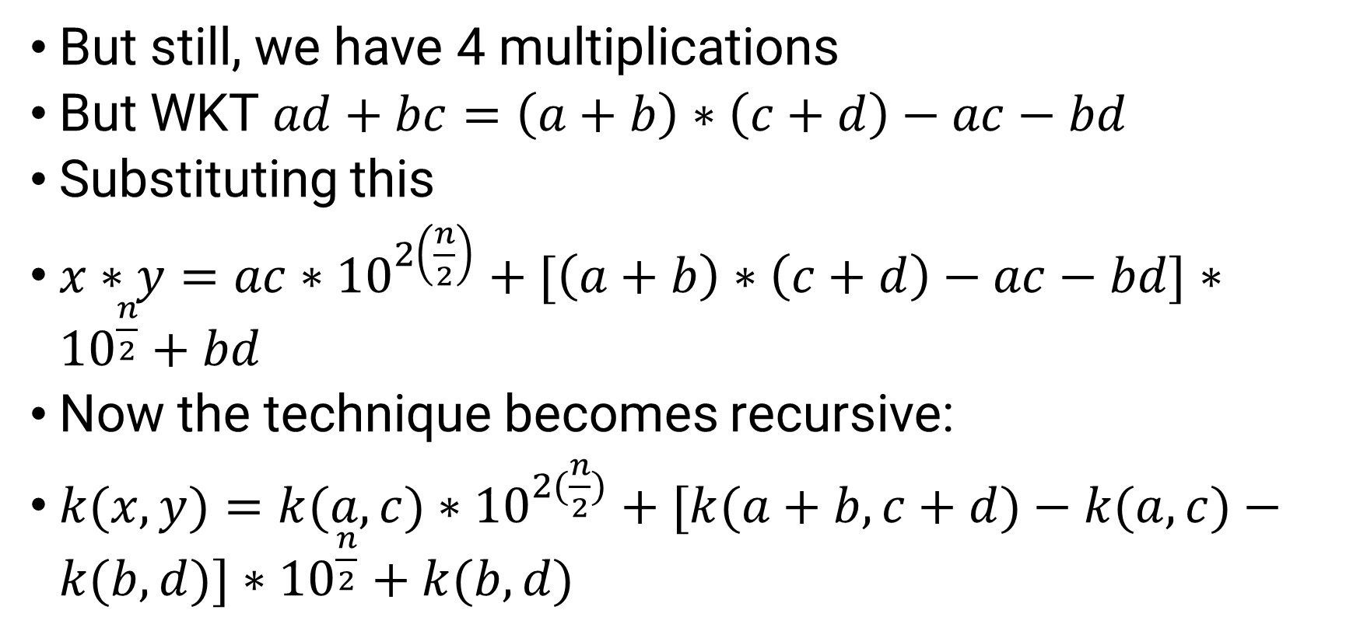
Karatsuba: Generalising
But still, we have 4 multiplications
But WKT $ad+bc=\left(a+b\right)∗\left(c+d\right)−ac−bd$
Substituting this
$x∗y=ac∗{10}^{2\left(\frac{n}{2}\right)}+[\left(a+b\right)∗\left(c+d\right)−ac−bd]∗{10}^{\frac{n}{2}}+bd$
Now the technique becomes recursive:
$k(x,y)=k(a,c)∗{10}^{2(\frac{n}{2})}+[k(a+b,c+d)−k(a,c)−k(b,d)]∗{10}^{\frac{n}{2}}+k(b,d)$

Slide 8
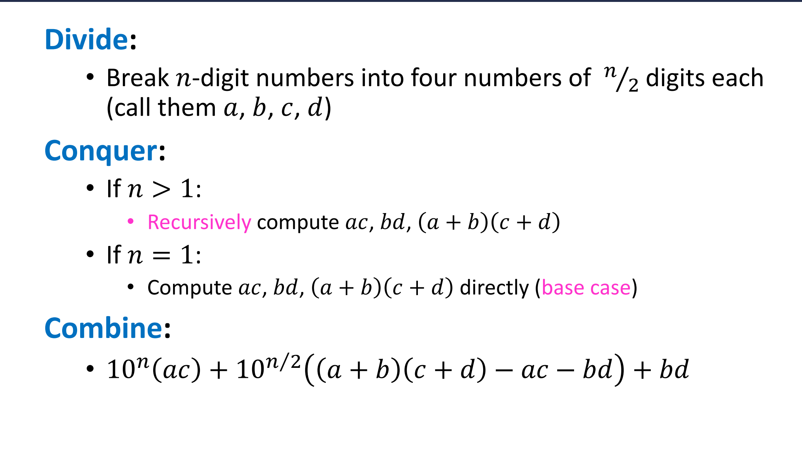
Karatsuba D&C Working

Slide 9
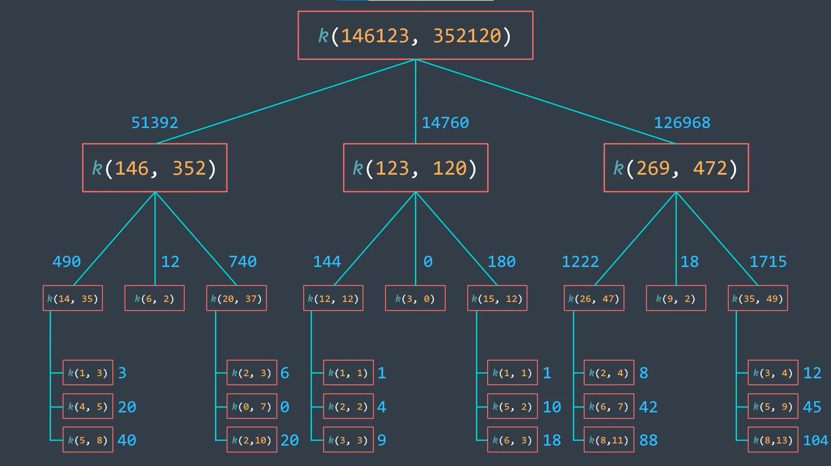

Slide 10

Karatsuba Demo
On board
$x=1026732$, $y=732912$ find $x∗y$

Slide 11
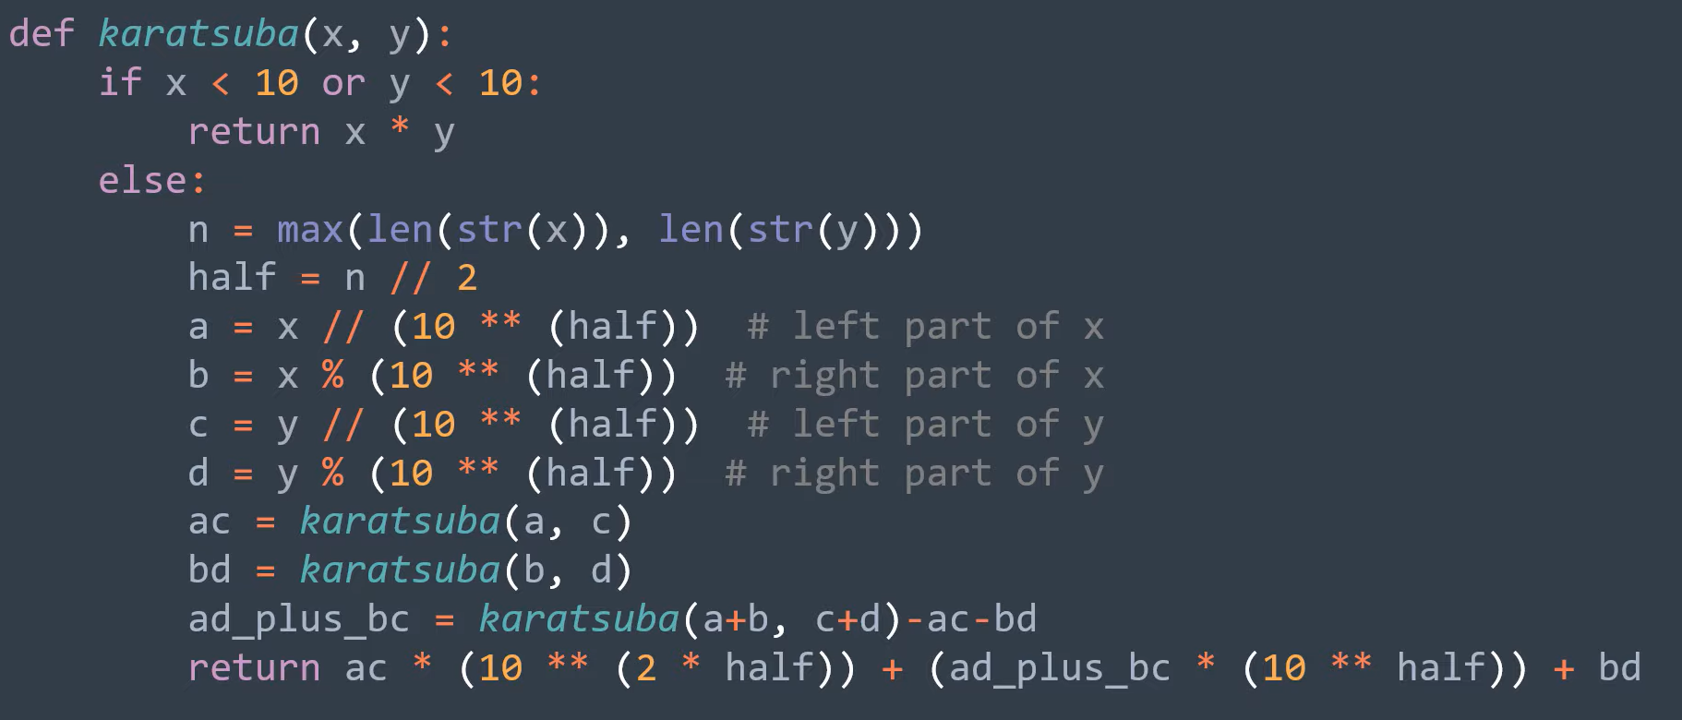
Pseudocode (After digit adjustments)

Slide 12
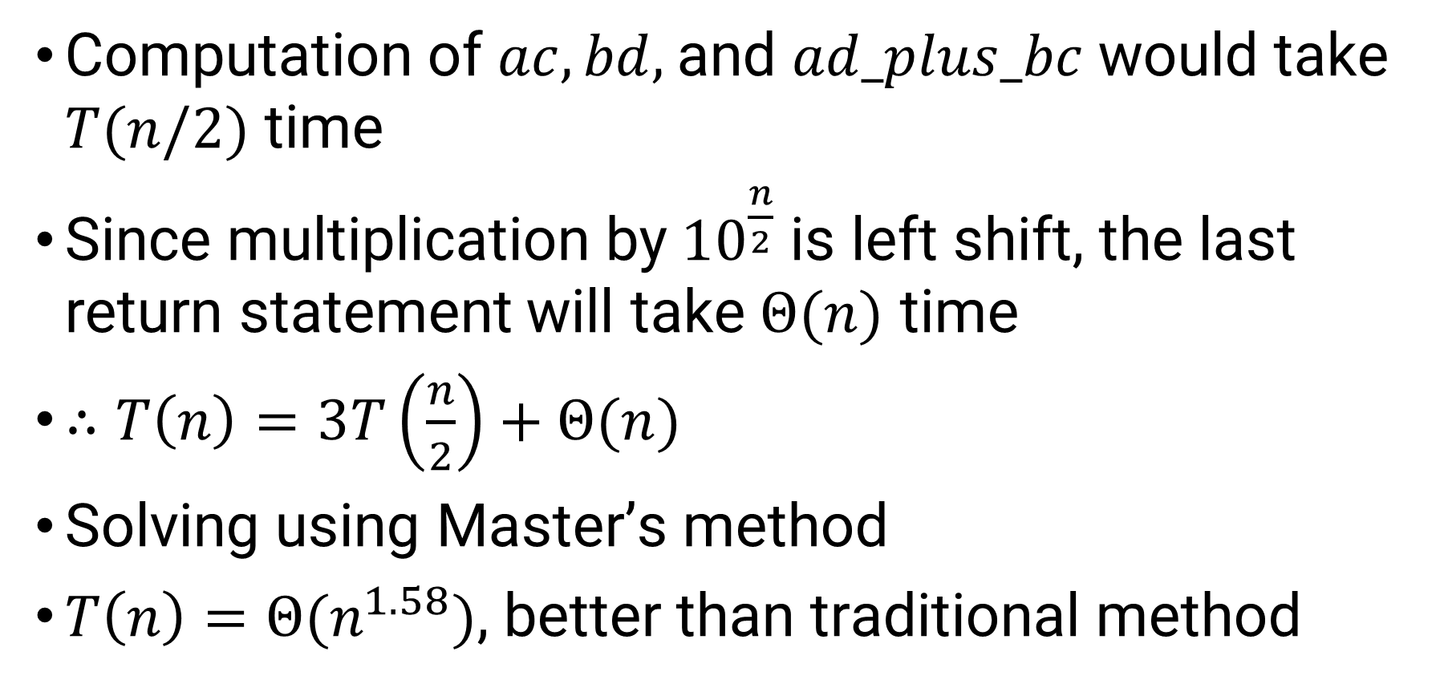
Analysis
Computation of $ac,bd,$and $ad_plus_bc$would take $T(n/2)$ time
Since multiplication by${10}^{\frac{n}{2}}$ is left shift, the last return statement will take $Θ(n)$ time
$∴T\left(n\right)=3T\left(\frac{n}{2}\right)+Θ(n)$
Solving using Master’s method
$T\left(n\right)=Θ(n^{1.58})$, better than traditional method

Slide 13
Thank you..

